Slide 1

Causal Discovery for Effective Connectivity in Human Brains
18 December 2013
Ramon Janssen, Tom de Ruijter
Supervision by Max Hinne, Tom Claassen
Notes:
Pose research problem

Slide 2


What is causality?

Slide 3
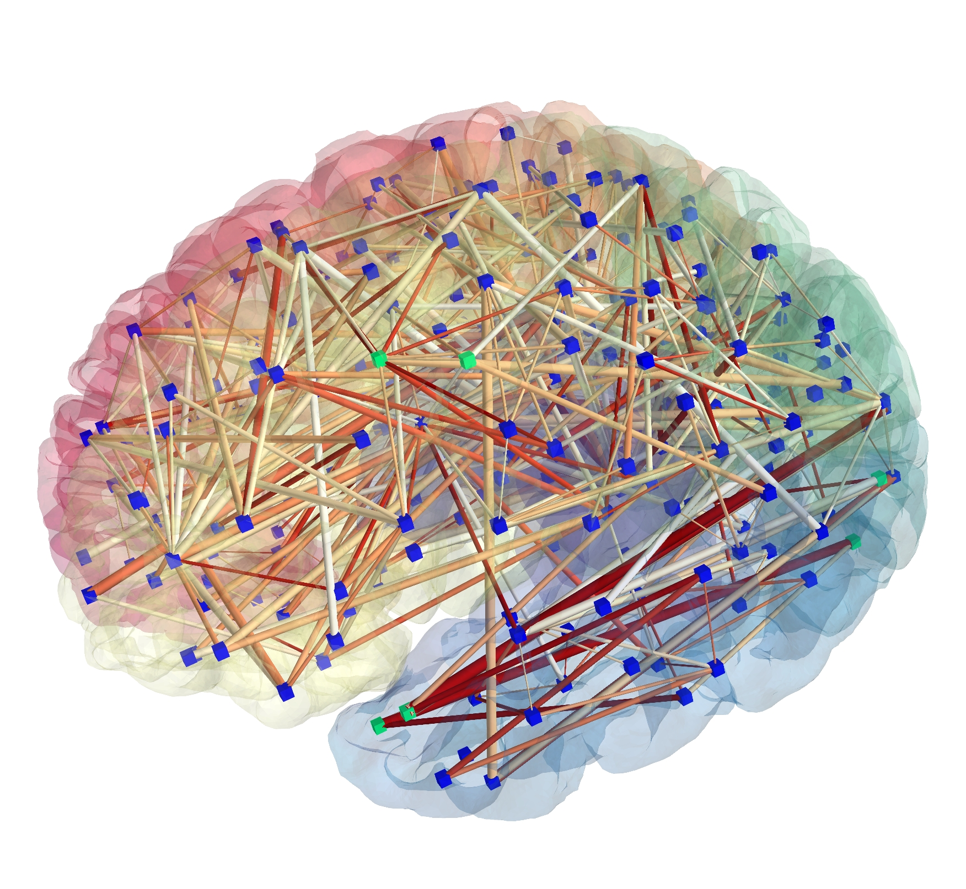
What is causality?

Slide 4
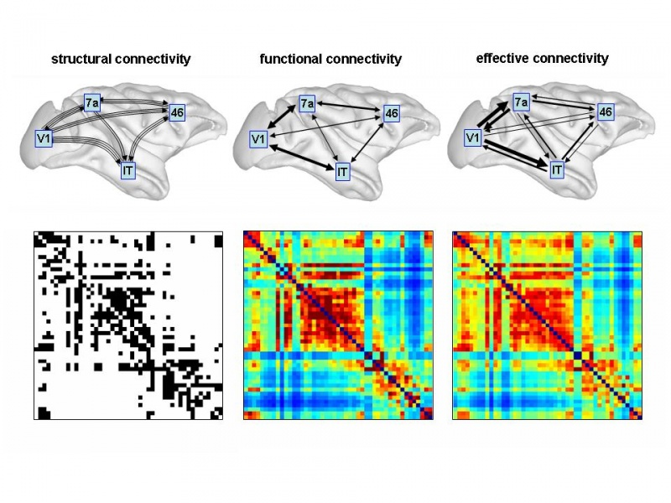
Brain Connectivity
Notes:
Give overview of rest of presentation

Slide 5
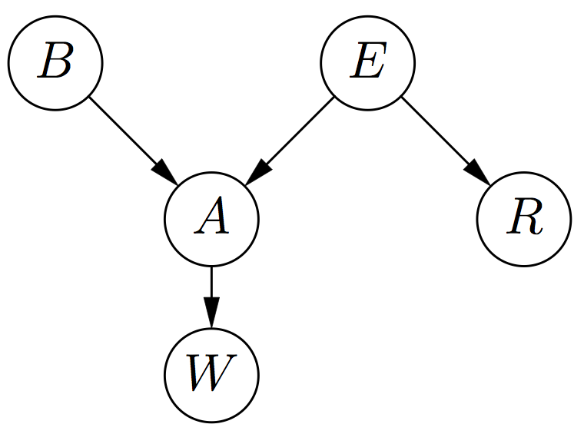
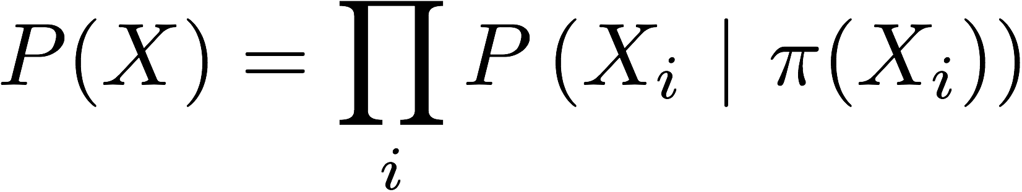
Causal Discovery
Represent dependencies between variables as a Directed Acyclic Graph (DAG)
Probabilistic interpretation:

Slide 6
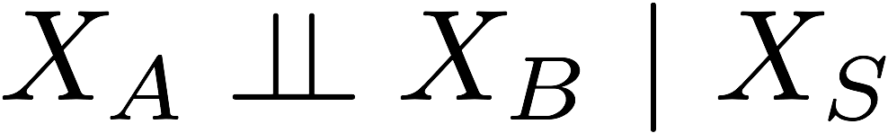
Directed Separation
Any two subsets of variables are conditionally independent given a separating subset:
where every path from a node in A to a node in B is blocked by S.
A and B are d-separated given S.

Slide 7
Causal interpretation
Underlying causal structure can be modeled by a DAG
and
A phenomenon is independent of its non-effects given its direct causes
(Causal Markov Condition)

Slide 8

Causal discovery
A
C
Based on very simple rules
Finding directions based on only structure is done with V-structures
B
A
C
A
C
?
B
B
A
C
B
Notes:
Zero order independency

Slide 9
Causal discovery
A
C
Based on very simple rules
Finding directions based on only structure is done with V-structures
B
A
C
A
C
?
B
B
A
C
B

Slide 10
Causal discovery
A
C
Based on very simple rules
Finding directions based on only structure is done with V-structures
B
A
C
A
C
?
B
B
A
C
B
Notes:
Zero order independency

Slide 11
Causal discovery
A
C
Based on very simple rules
Finding directions based on only structure is done with V-structures
B
A
C
A
C
?
B
B
A
C
B
Notes:
Zero order independency

Slide 12
Causal sufficiency (closed world assumption)
Latent variables
A
A
B
C
B
C

Slide 13
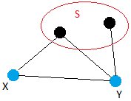
Algorithm: Structure with PC
STEP 1
Take a two connected points X and Y
Test whether X and Y are statistically independent given any set S of other points
If so, remove the edge between X and Y. S is recorded as a separating set of {X, Y}
“Standard” PC stops after finding one set.
Our adjusted version tries to find multiple sets
Repeat for all pairs and all sets…

Slide 14
Algorithm: Structure with PC
STEP 1
Take a two connected points X and Y
Test whether X and Y are statistically independent given any set S of other points
If so, remove the edge between X and Y. S is recorded as a separating set of {X, Y}
“Standard” PC stops after finding one set.
Our adjusted version tries to find multiple sets
Repeat for all pairs and all sets…

Slide 15
Algorithm: direction with PC
STEP 2
Using the structure from the previous step, find V-structures
Orient V-structures depending on the separating sets
Our version explicitly tests for independence
Some other simple rules to orient edges

Slide 16
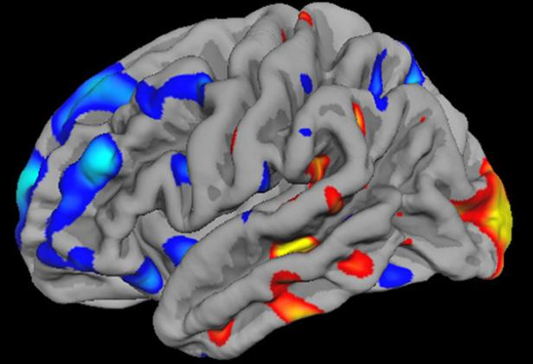
What we have
fMRI measurements of six subjects
Activity of the brain
For 116 brain regions and 1029 time frames

Slide 17
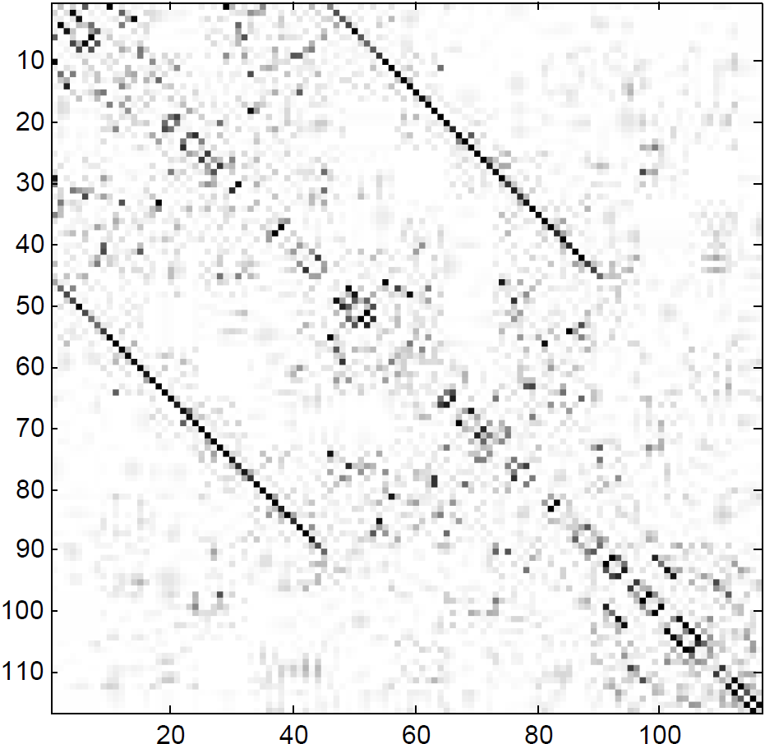
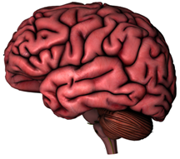
Structure
Left hemisphere
Right hemisphere
Cerebellum
Left hemisphere
Right hemisphere
Cerebellum

Slide 18
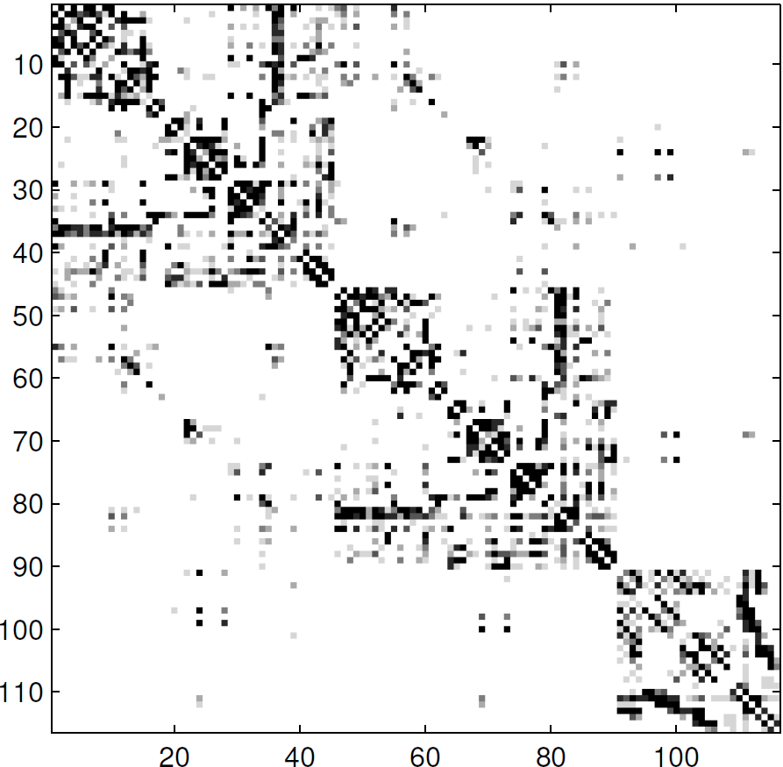
Structure
Found by Hinne at al:
Found with PC:

Slide 19
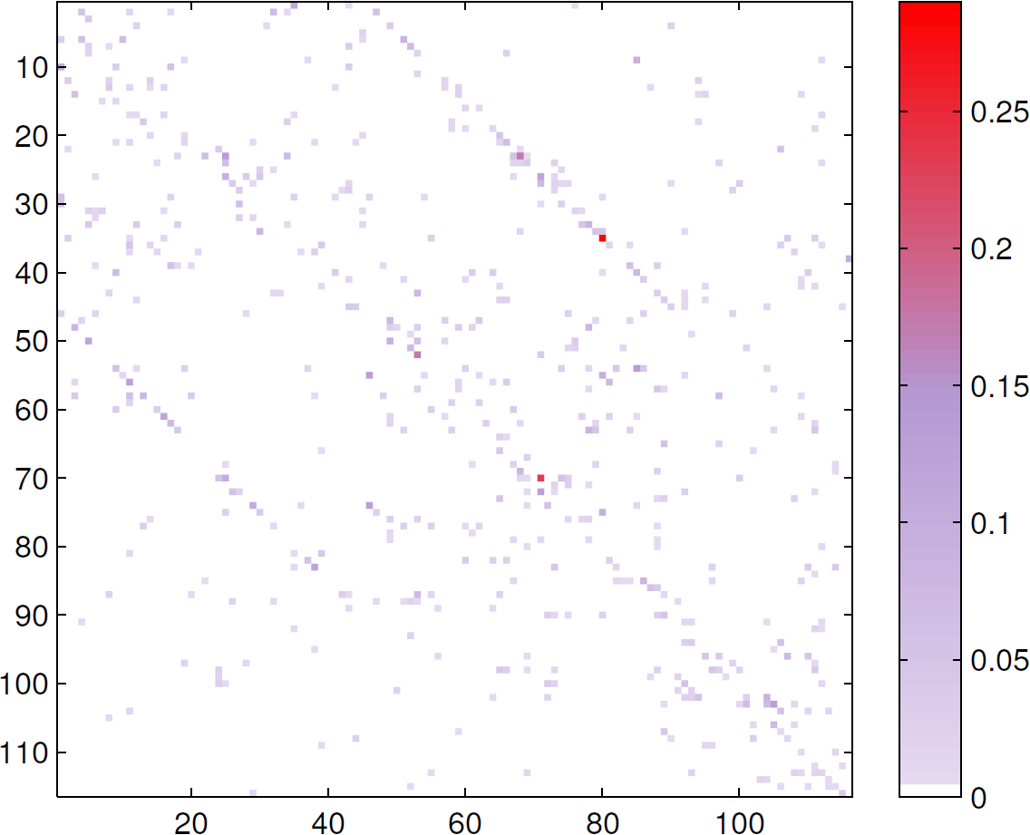
Direction
Many double arrows and little single-oriented arrows
Little consistency between subjects and regions

Slide 20
Discussion
Promising research, but …
Model oriented
Incorrect model assumptions
Coarse data
No anatomical plausibility found yet
Future research
Task oriented vs. resting-state
Bayesian methods
Causal feedback
Notes:
Summarize at end of slide

Slide 21
Thank you for your attention

